Slide 1
Shame
Our Fall from Glory

Slide 2
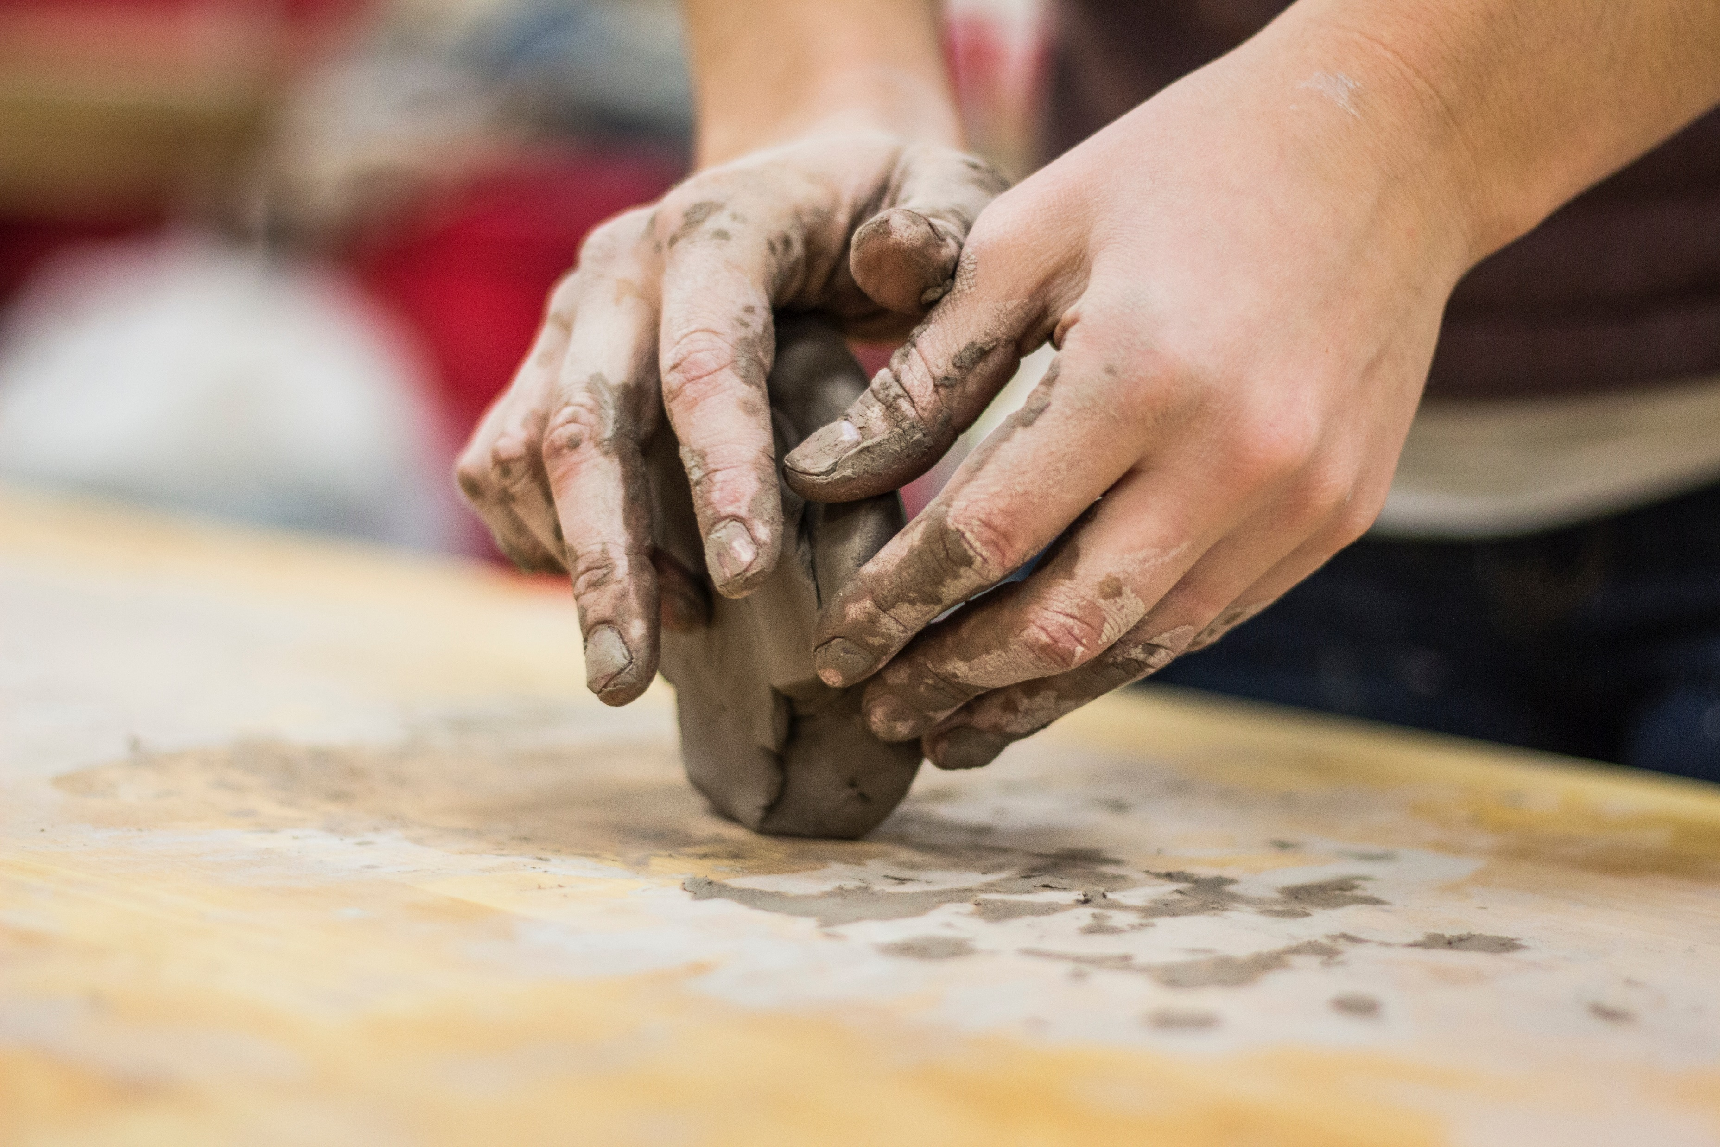
Recap of Previous Sessions
We Were Created in God’s Image
To relate to Him and bear a resemblance to Him like children relate to and bear resemblance to their parents (Gen 5:3)
To represent Him on the earth He created. (Gen 1:26)

Slide 3
Recap of Previous Sessions
God = Love
X Not simply “God loves”
X Not “Love is God”
BUT
God is Love

Slide 4
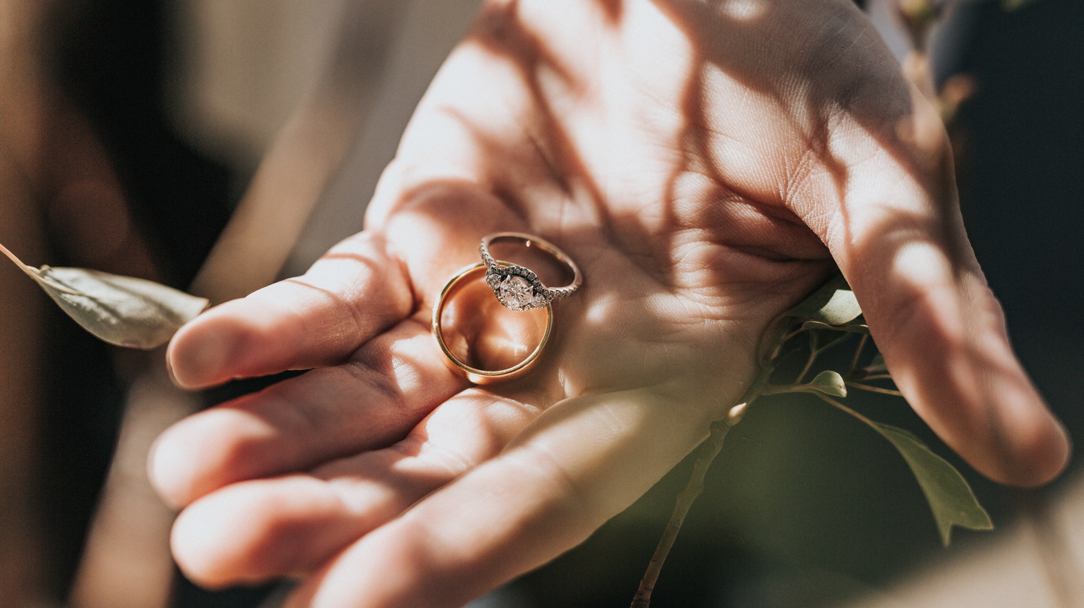
Love Invites a Response
What if someone came up to you and told you they loved you?

Slide 5
Possible Responses
Acceptance
Rejection
Indecision

Slide 6
Gen 2:7, 15-23; 3:1-6 (NLT)
The Lord God formed the man from the dust of the ground. He breathed the breath of life into the man’s nostrils, and the man became a living person. Then the Lord God planted a garden in Eden in the east, and there he placed the man he had made.
The Lord God made all sorts of trees grow up from the ground—trees that were beautiful and that produced delicious fruit. In the middle of the garden he placed the tree of life and the tree of the knowledge of good and evil.

Slide 7
The Lord God placed the man in the Garden of Eden to tend and watch over it. But the Lord God warned him, “You may freely eat the fruit of every tree in the garden— except the tree of the knowledge of good and evil. If you eat its fruit, you are sure to die.”
Then the Lord God said, “It is not good for the man to be alone. I will make a helper who is just right for him.” So the Lord God formed from the ground all the wild animals and all the birds of the sky. He brought them to the man to see what he would call them, and the man chose a name for each one. He gave names to all the livestock, all the birds of the sky, and all the wild animals. But still there was no helper just right for him.
Notes:
Helper – used of God in Ex 18:4, staff and troops of a rule Ez 12:14
Just right = corresponding to him i.e. equal and adequate to himself

Slide 8
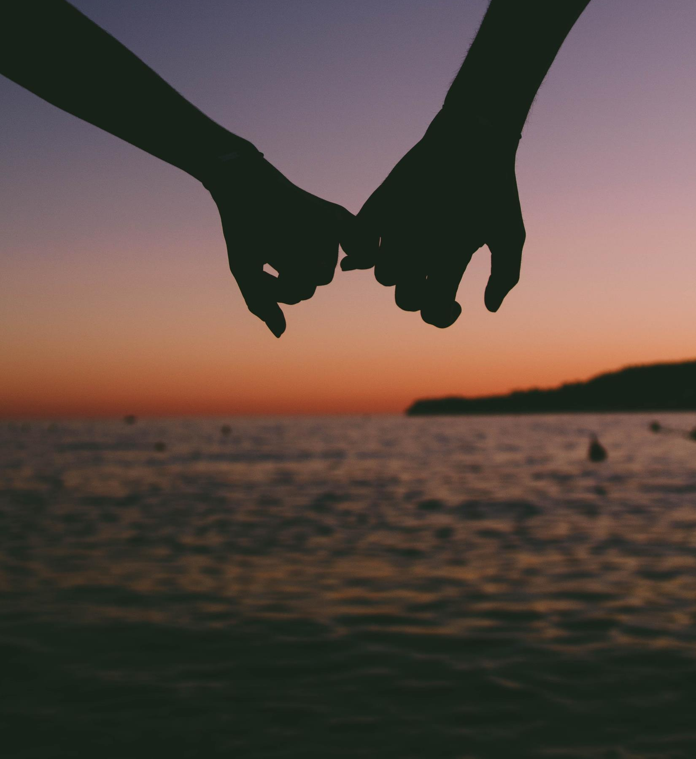
So the Lord God caused the man to fall into a deep sleep. While the man slept, the Lord God took out one of the man’s ribs and closed up the opening. Then the Lord God made a woman from the rib, and he brought her to the man.
“At last!” the man exclaimed.
“This one is bone from my bone,
and flesh from my flesh!
She will be called ‘woman,’
because she was taken from ‘man.’”

Slide 9
The serpent was the shrewdest of all the wild animals the Lord God had made. One day he asked the woman, “Did God really say you must not eat the fruit from any of the trees in the garden?” “Of course we may eat fruit from the trees in the garden,” the woman replied. “It’s only the fruit from the tree in the middle of the garden that we are not allowed to eat. God said, ‘You must not eat it or even touch it; if you do, you will die.’” “You won’t die!” the serpent replied to the woman. “God knows that your eyes will be opened as soon as you eat it, and you will be like God, knowing both good and evil.”

Slide 10
The woman was convinced. She saw that the tree was beautiful and its fruit looked delicious, and she wanted the wisdom it would give her. So she took some of the fruit and ate it. Then she gave some to her husband, who was with her, and he ate it, too

Slide 11
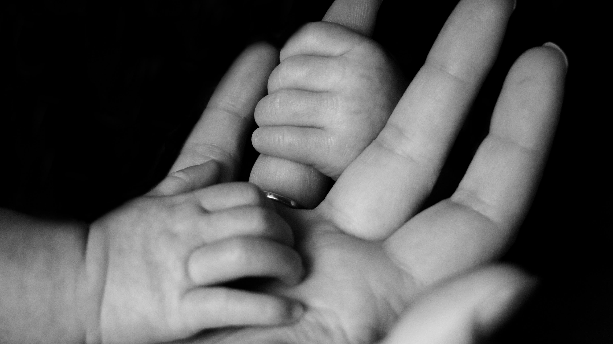
How does God show His love for the man and woman in this story?
God provided for every need of the man and woman –
A beautiful place to live
Food to eat
Companionship
How did the man and woman respond to God’s love?
Notes:
What are the ways in which we see God’s love?
God provided for every need of the man and woman (a beautiful place to live, food to eat, companionship, He cared for all their needs and desires)
God wanted to protect them (that’s why He warns them about eating from the tree)
How did the man and woman respond to God’s love?
They didn’t trust that He loved them (the serpent made them think that maybe God was trying to keep something good from them, He didn’t want them to have all the power He has and that’s why He had told them not to eat the fruit of the tree of the knowledge of good and evil)
They didn’t trust God’s word

Slide 12
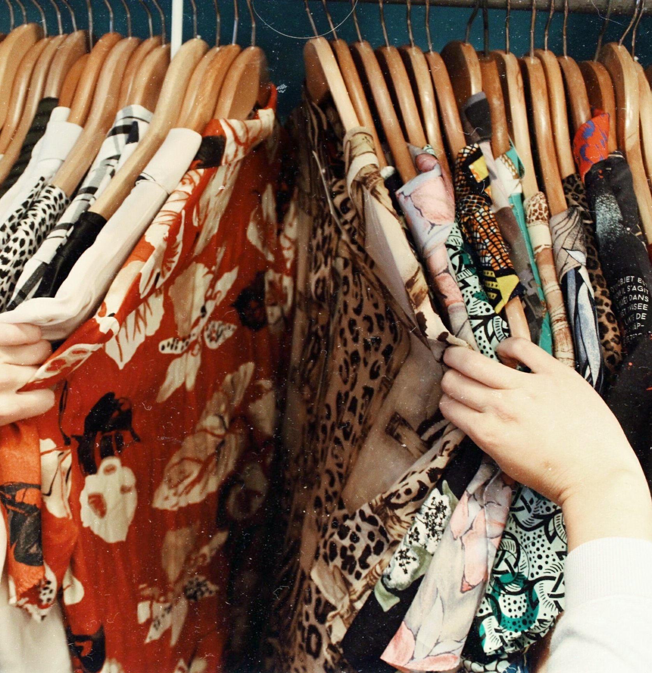
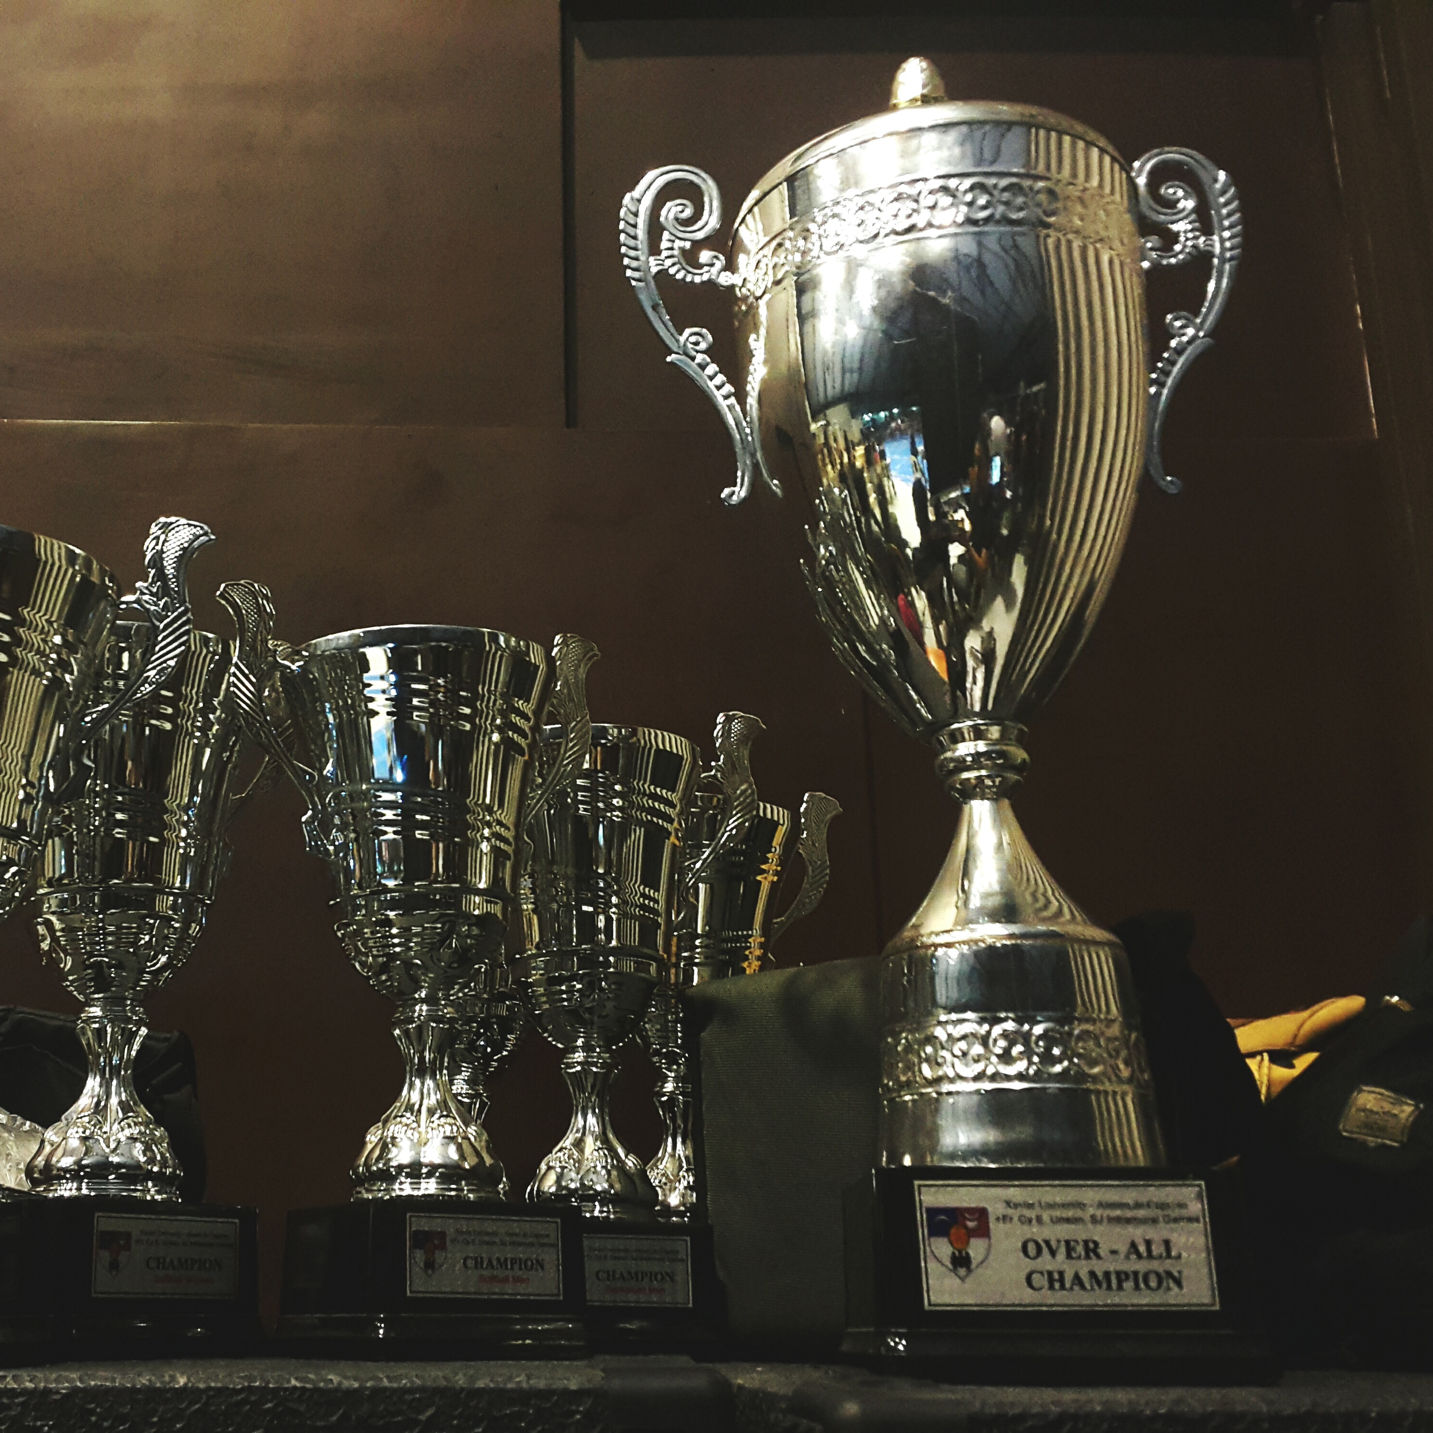
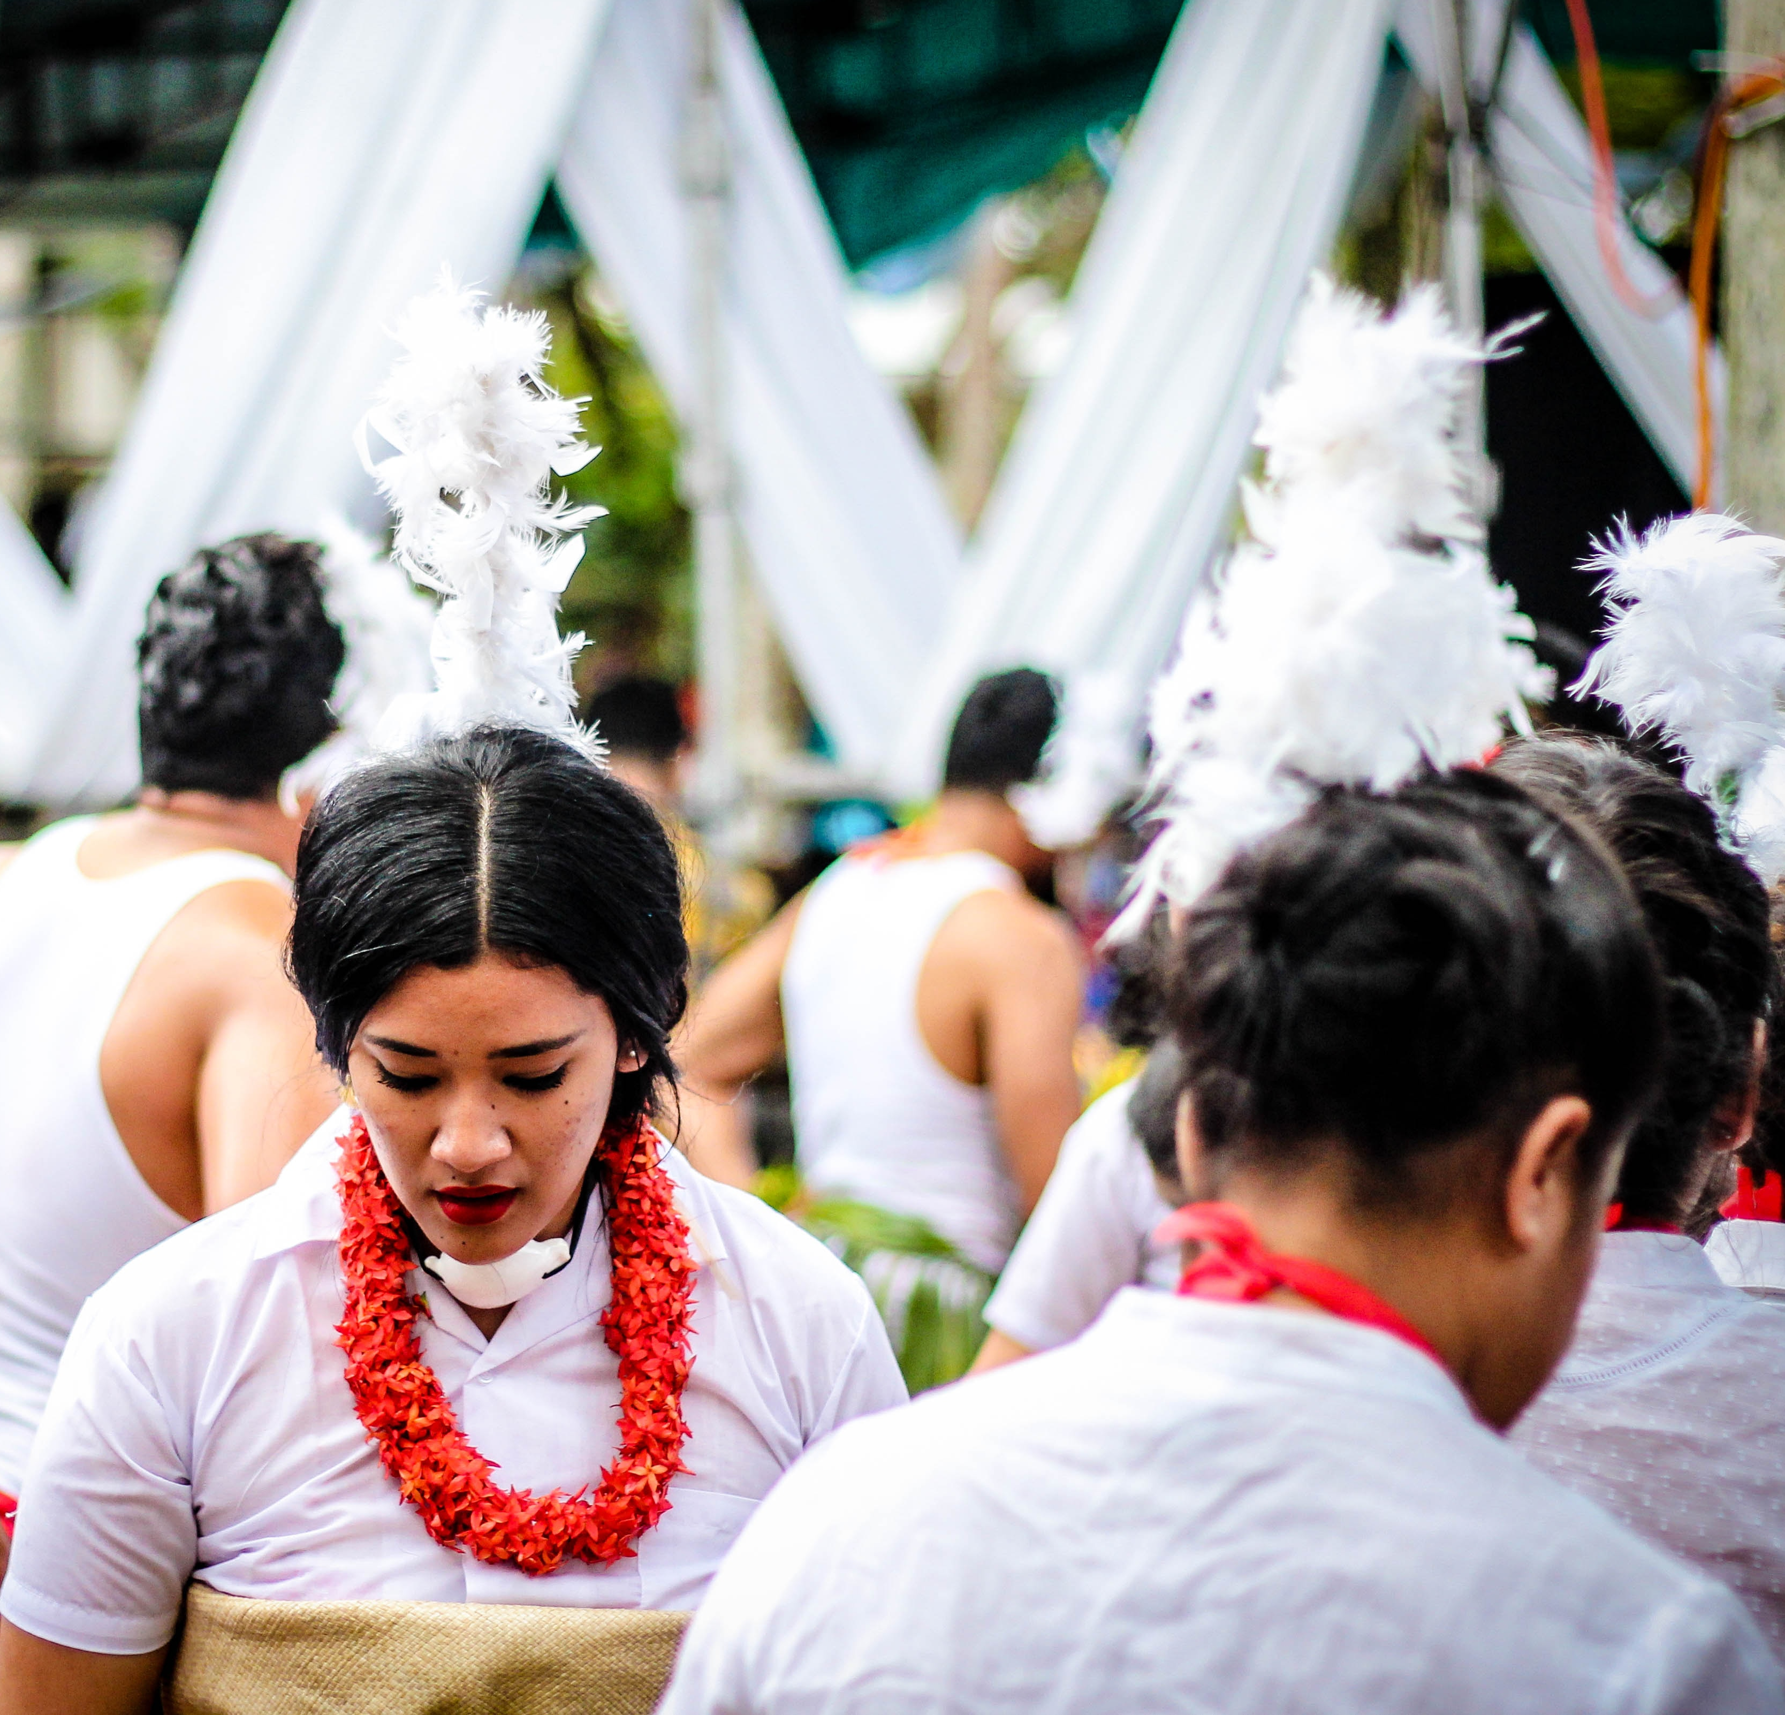
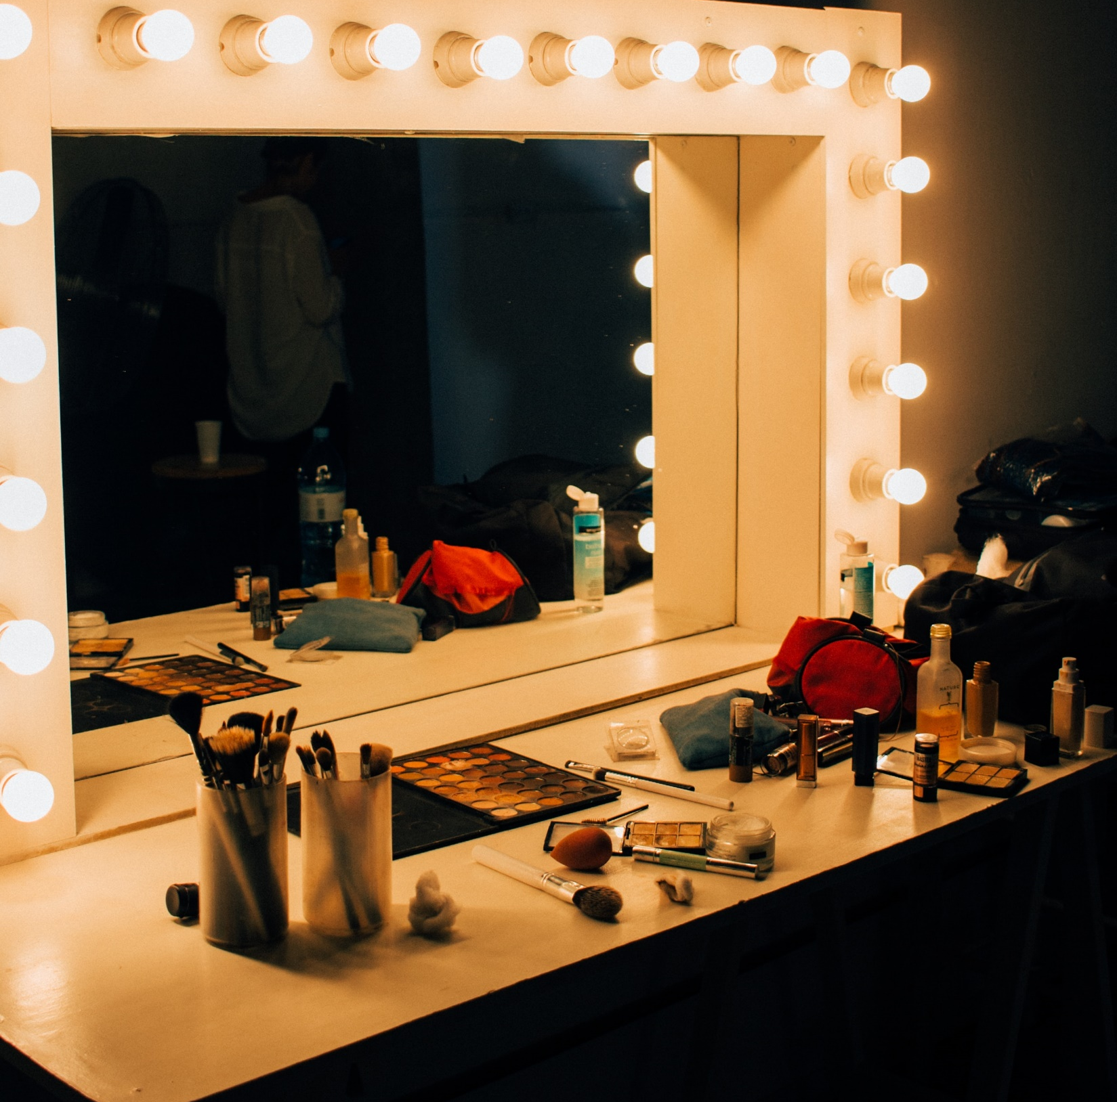
A Consequence of the Man and Woman’s Response
Humanity’s search for honour

Slide 13
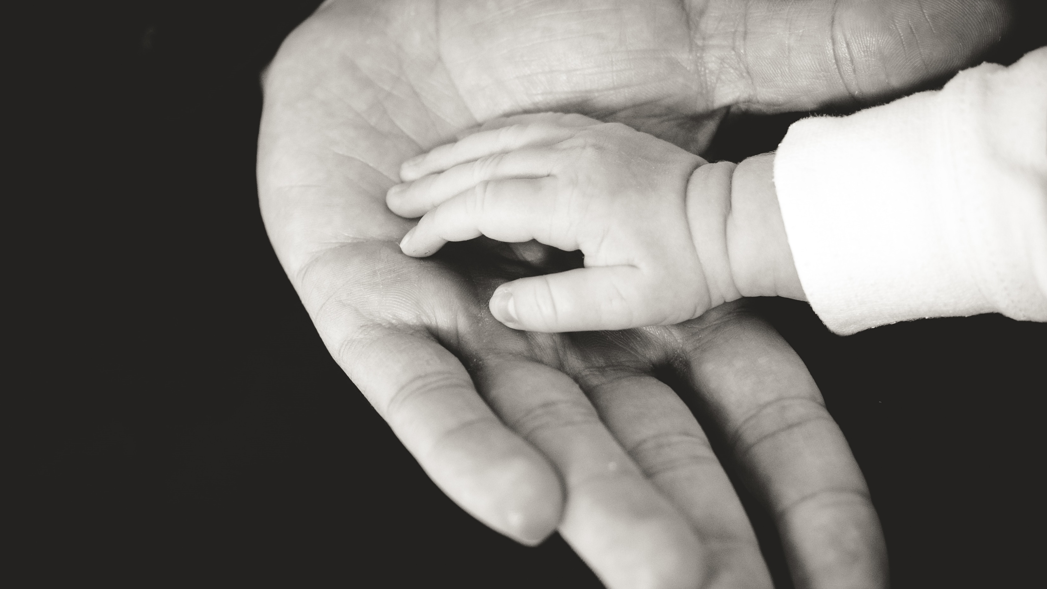
But God Did Not Stop Loving Us
If there’s one person who would accept us
just
as
we
are,
it is God

Slide 14
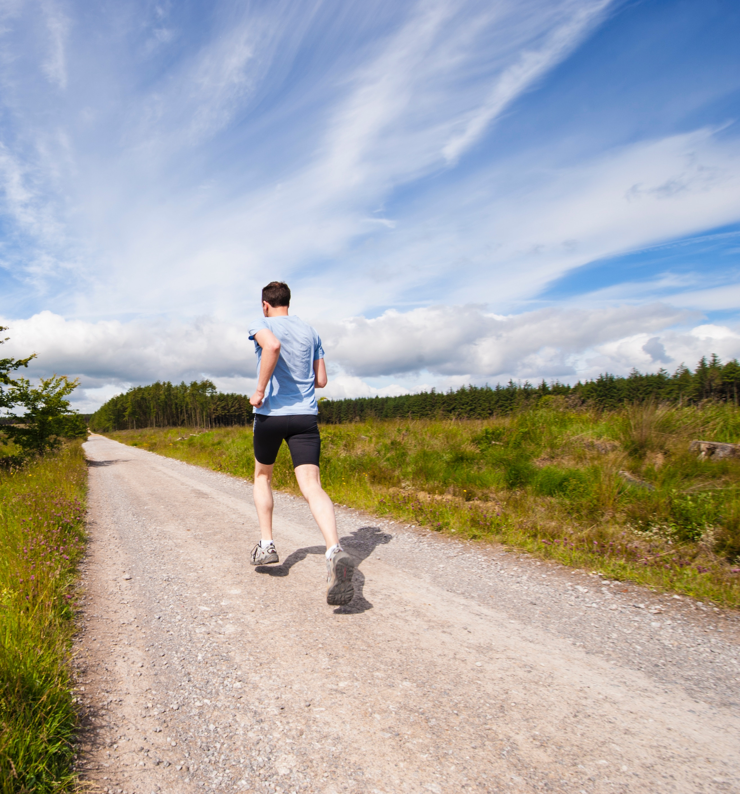
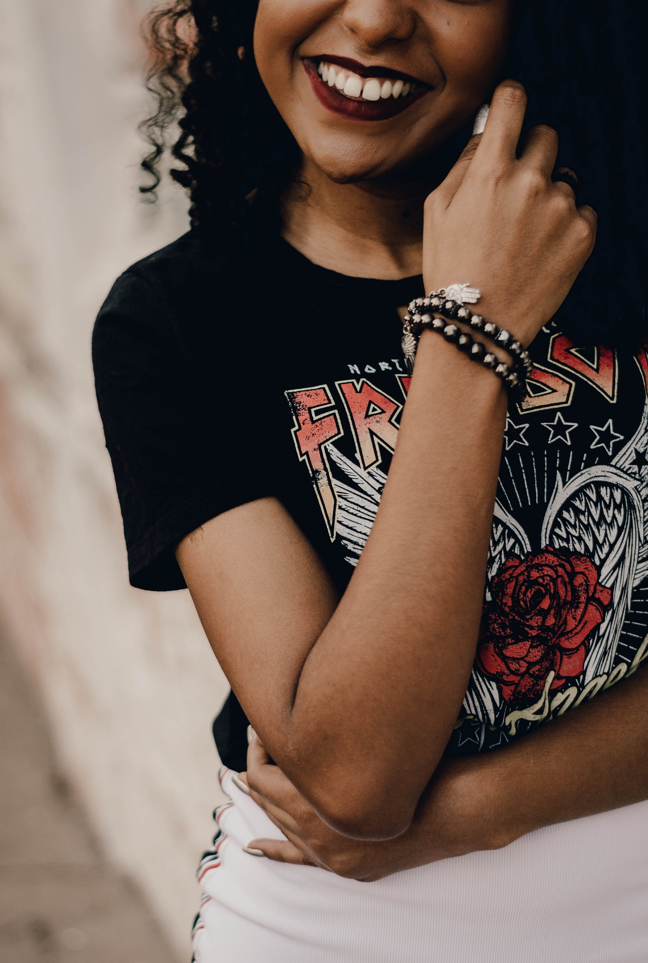
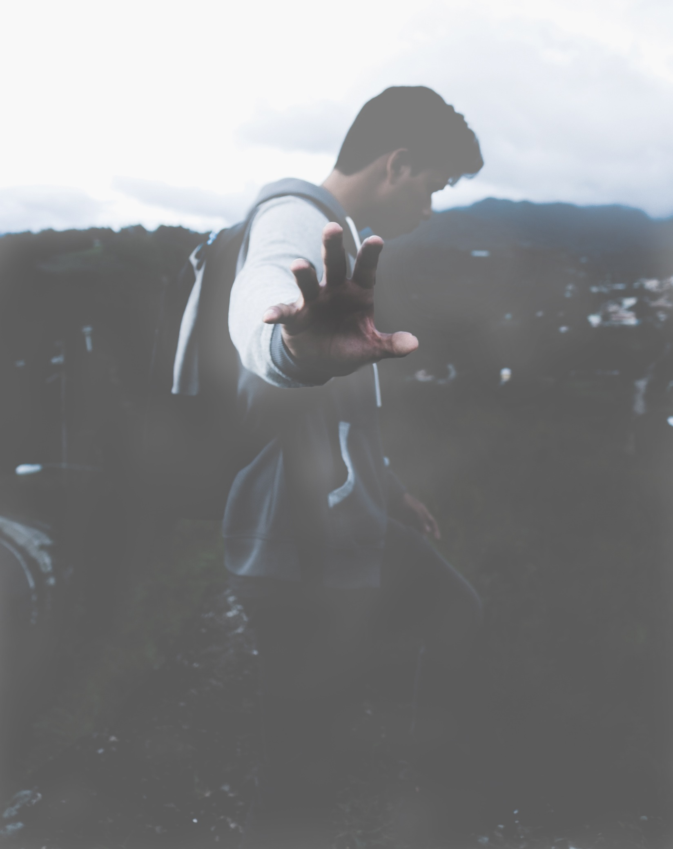
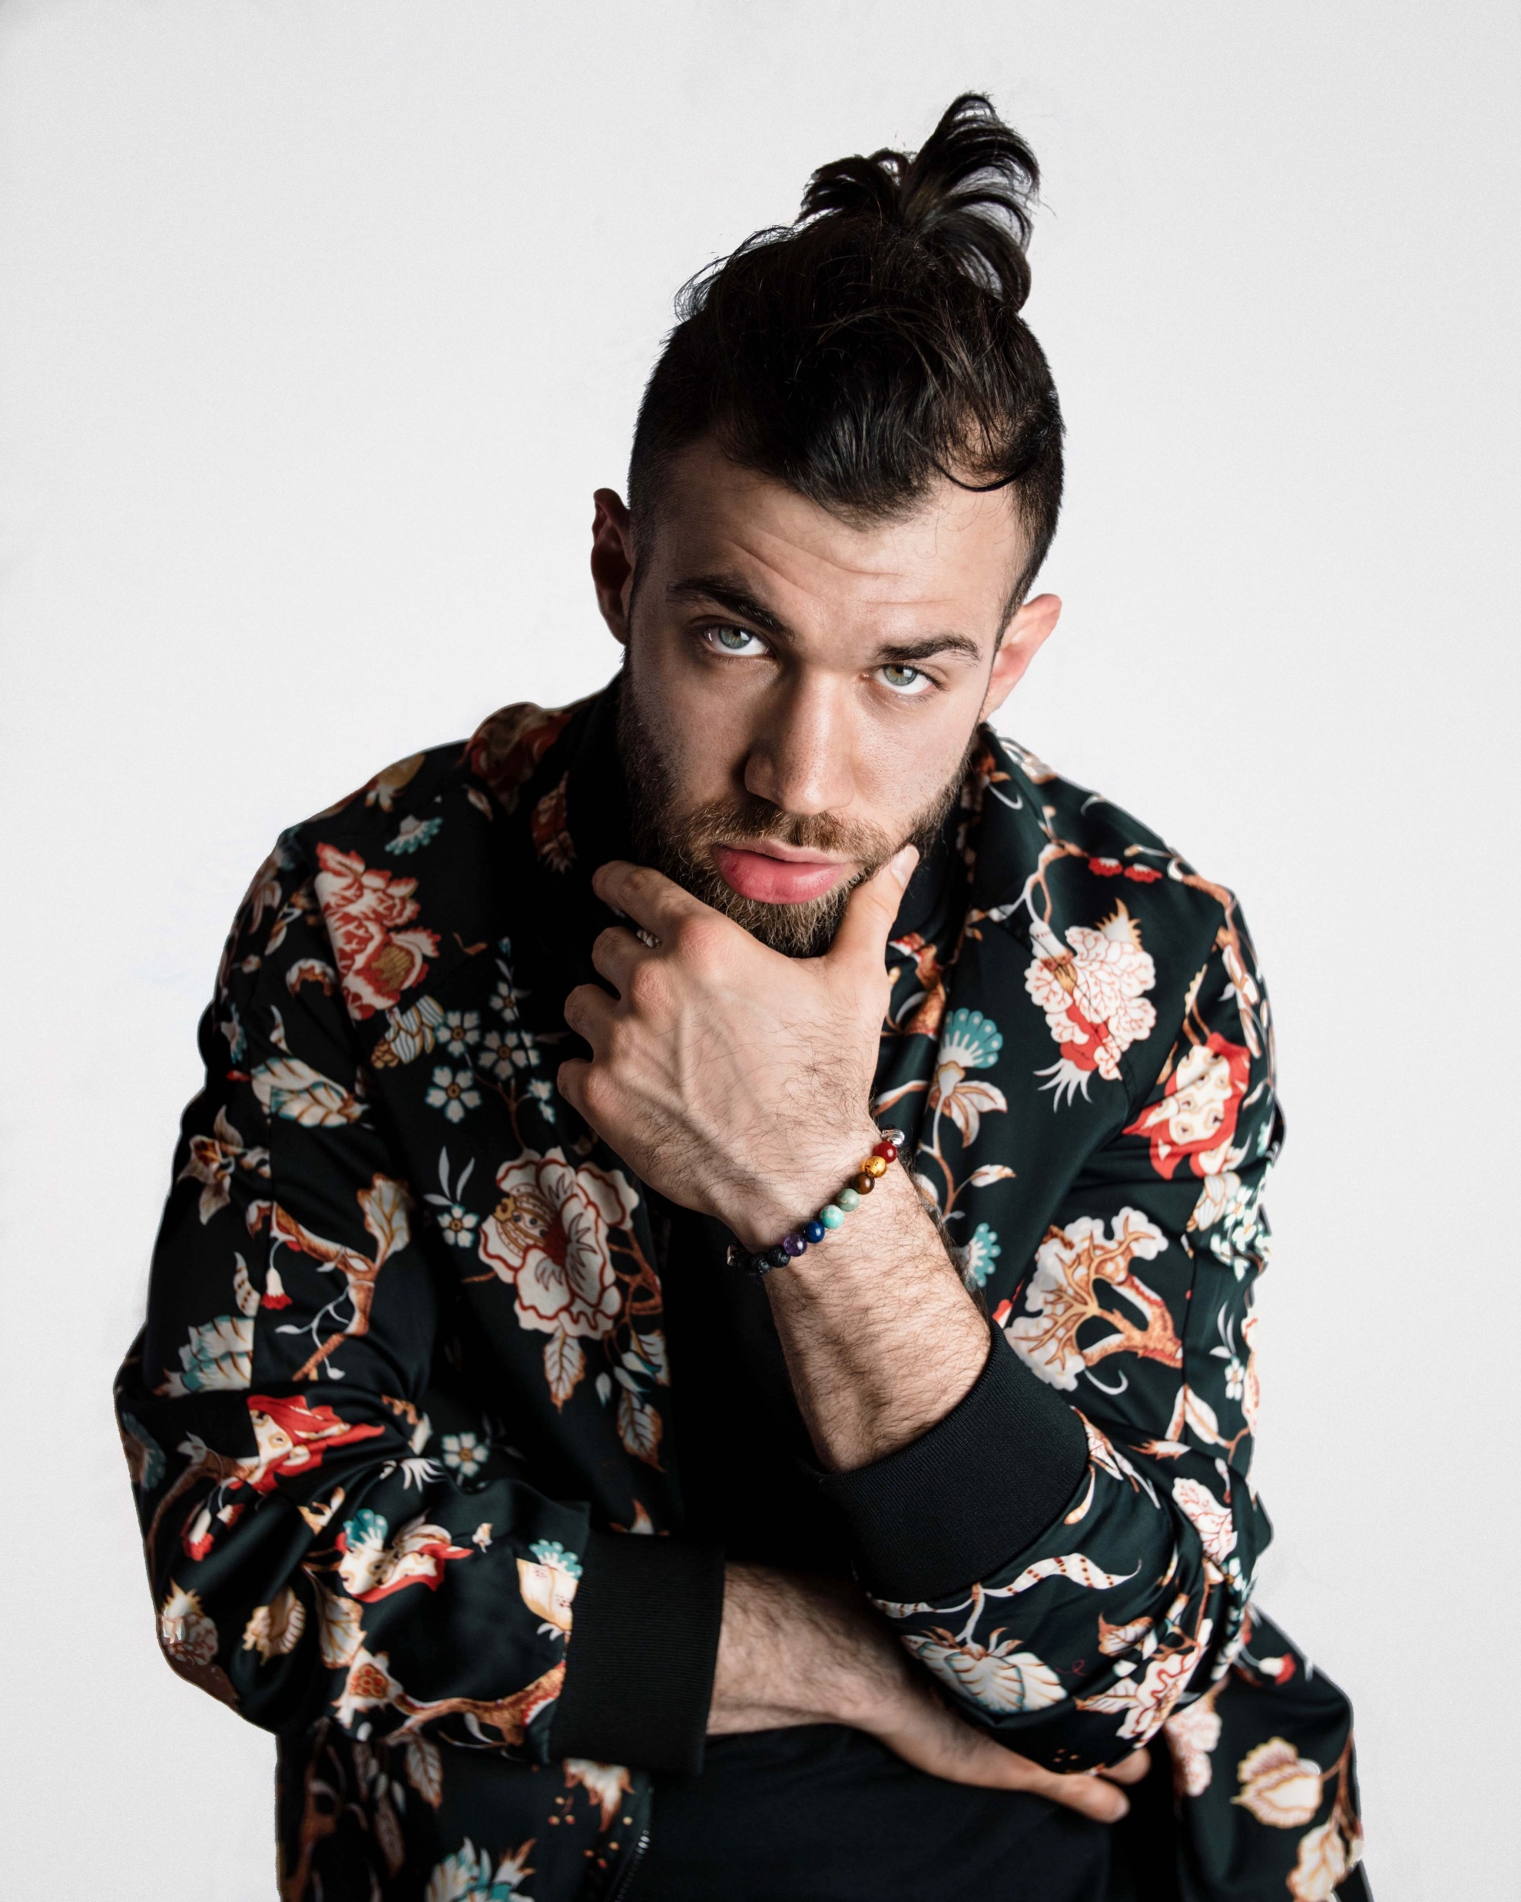
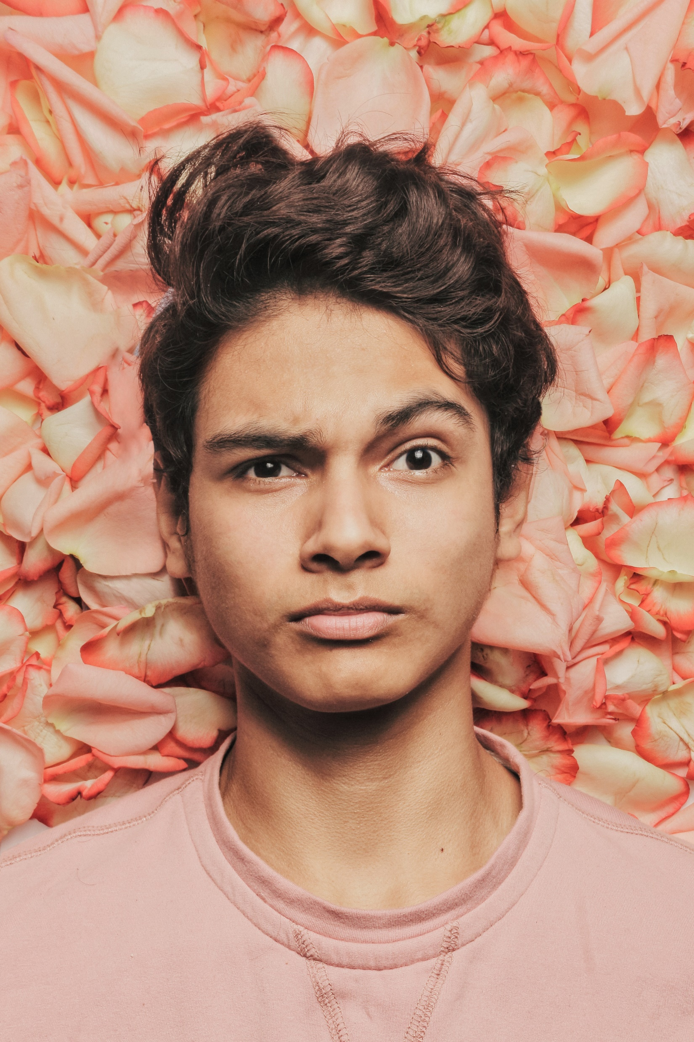
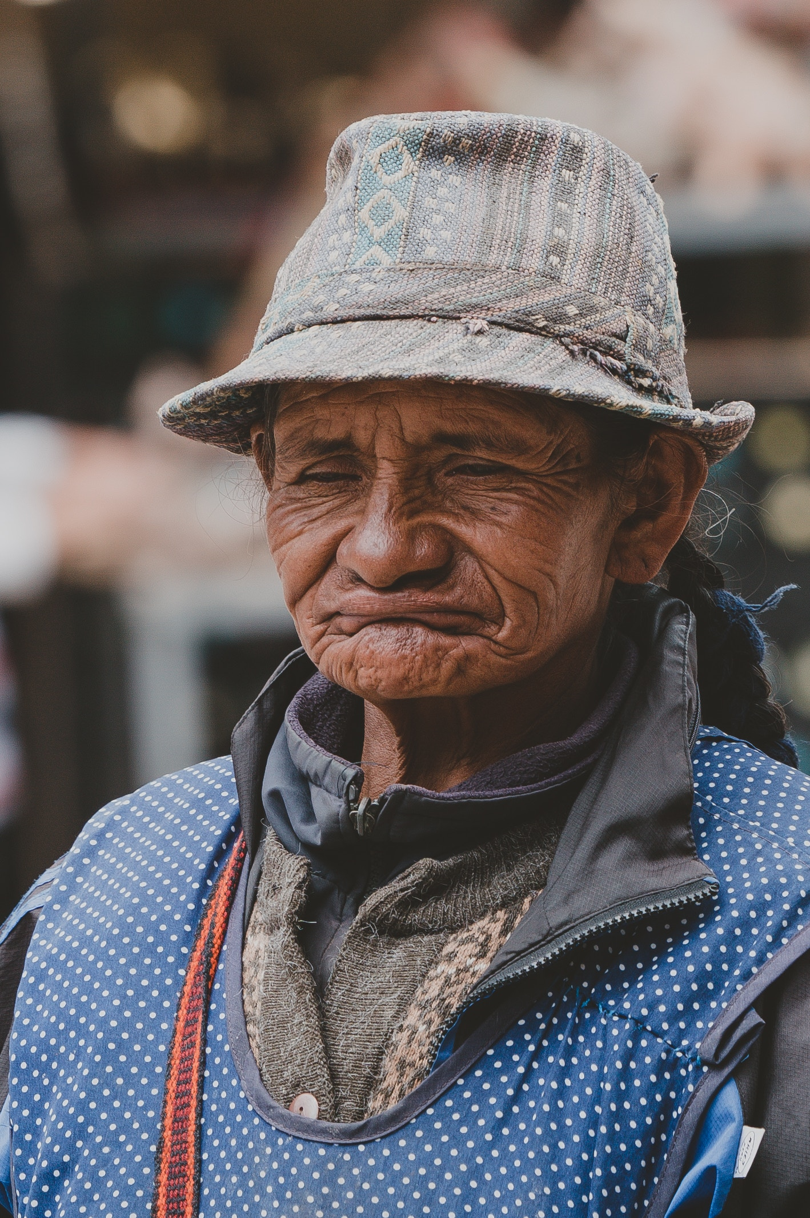
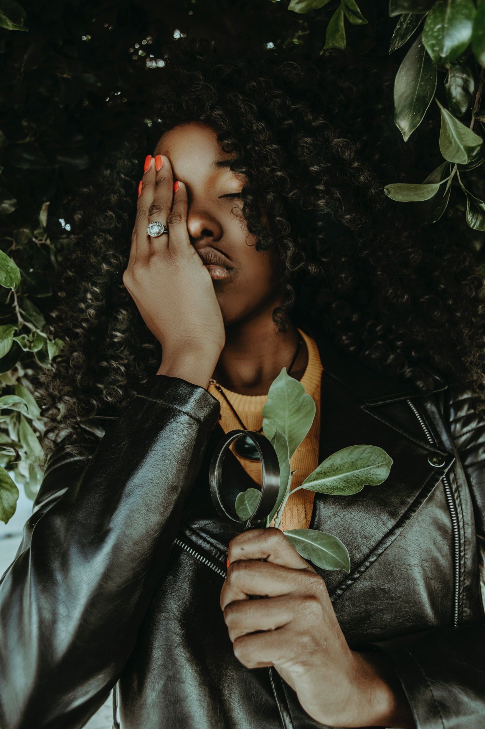
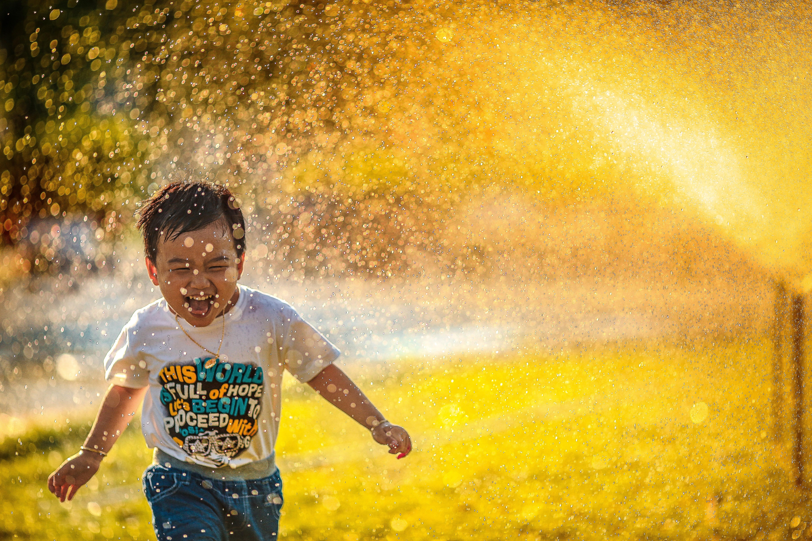
How will you respond to God’s love?

