Slide 1
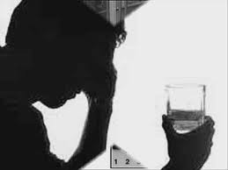
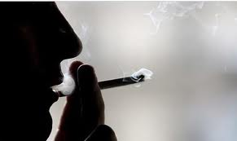
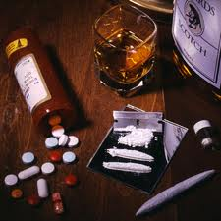

Slide 2
An addiction is a compulsive obsessive behavior that controls a person.
An addict is someone who surrenders himself or herself to something habitually or obsessively.

Slide 3
There are some needs that we are born with, and some that are acquired

Slide 4
Real freedom is not the liberty to do anything you feel like doing, but the ability to do the right you know you should be doing.

Slide 5
Things could we be addicted to:
Substances
Behavior patterns
Things that bring pleasure
Things we do

Slide 6
Why would addictions be wrong?
Wrong personally
Wrong morally
Wrong spiritually
Wrong communally

Slide 7
What causes/initiates addictions?
Peer-pressure
Rebellion
Escape
Curiosity
Family Environment

Slide 8
How do addictions develop?
Initial Experiment →
Recurring Desire →
Obsessive Habit →
Powerless Control

Slide 9
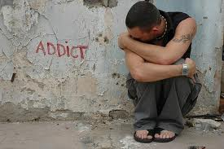
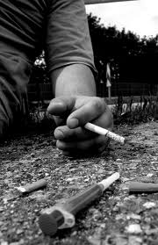
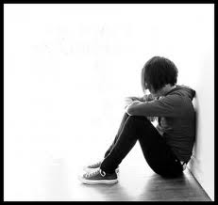
The world of an addict
Fear
Pain
Withdrawal
Denial
Pre-occupation

Slide 10
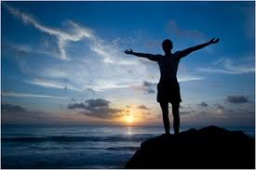
The Road to Freedom
So easy to get in, so hard to get out. The way in is a road of pleasure. The way out is a path of pain.

Slide 11
The Road to Freedom
John 8:34,36
34 Jesus answered them, "Most assuredly, I say to you, whoever commits sin is a slave of sin.
36 Therefore if the Son (Jesus) makes you free, you shall be free indeed.

Slide 12
The Road to Freedom
“Truth is temporarily painful, but permanently liberating”.
All permanent change comes from within.

Slide 13
The Road to Freedom
1. Recognize there is a problem and that it is sinful
Proverbs 28:13
He who covers his sins will not prosper, But whoever confesses and forsakes them will have mercy.

Slide 14
The Road to Freedom
1. Recognize there is a problem and that it is sinful
“Sin is not hurtful because it is forbidden but sin is forbidden because it is hurtful” (Arthur H. Elfstrand)

Slide 15
The Road to Freedom
2. Take responsibility. Never blame someone else for your sin
You will never correct what you are unwilling to confront.

Slide 16
The Road to Freedom
3. Understand that will power alone can’t break addictions
Romans 7:
15 For what I am doing, I do not understand. For what I will to do, that I do not practice; but what I hate, that I do.
18 For I know that in me (that is, in my flesh) nothing good dwells; for to will is present with me, but how to perform what is good I do not find.
19 For the good that I will to do, I do not do; but the evil I will not to do, that I practice.

Slide 17
The Road to Freedom
3. Understand that will power alone can’t break addictions
Be willing to receive God's help through His Word, His Holy spirit, and sometimes through other people.
Christ broke the power of sin over your life through His death on the Cross.

Slide 18
The Road to Freedom
4. Pray and submit to God. Come to Him for help
Hebrews 2:18
For in that He Himself has suffered, being tempted, He is able to aid those who are tempted.
Hebrews 4:16
Let us therefore come boldly to the throne of grace, that we may obtain mercy and find grace to help in time of need.

Slide 19
The Road to Freedom
5. Get God's Word in
John 8:
31 Then Jesus said to those Jews who believed Him, "If you abide in My word, you are My disciples indeed.
32 And you shall know the truth, and the truth shall make you free."

Slide 20
The Road to Freedom
6. Put away/Stay away from what causes you to sin
Matthew 5:
29 If your right eye causes you to sin, pluck it out and cast it from you; for it is more profitable for you that one of your members perish, than for your whole body to be cast into hell.
30 And if your right hand causes you to sin, cut it off and cast it from you; for it is more profitable for you that one of your members perish, than for your whole body to be cast into hell.

Slide 21
The Road to Freedom
7.Resist demonic influences
James 4:7
Therefore submit to God. Resist the devil and he will flee from you.

Slide 22
The Road to Freedom
7. Resist demonic influences
1 John 5:18
We know that whoever is born of God does not sin; but he who has been born of God keeps himself, and the wicked one does not touch him.

Slide 23
The Road to Freedom
Jesus, makes you a brand new person, inside out!
2 Corinthians 5:17
Therefore, if anyone is in Christ, he is a new creation; old things have passed away; behold, all things have become new.

Slide 24
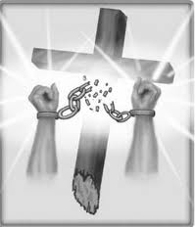
Jesus,
makes you a brand new person,
inside out!

